Slide 1

Lending Loan Case Study
Group Members
Astha Agarwal Vinay Prasad K

Slide 2
AGENDA
Overview- Problem Statement​
Methodology
Data Transformation – Cleaning and imputation
Exploratory Data Analysis
Univariate Analysis
Bivariate Analysis
Multivariate Analysis
​Conclusion​

Slide 3
Overview
About Company : Lending Club is the largest online loan marketplace, facilitating personal loans, business loans, and financing of medical procedures. Borrowers can easily access lower interest rate loans through a fast online interface.
Problem Statement: Analyze data to identify
Driving factors behind loan default, i.e. the variables which are strong indicators of default.
Consumer attributes and loan attributes that influence the tendency of default.

Slide 4
Methodology
Data Cleaning
Bivariate Analysis
Multivariate Analysis
Derived Column
Univariate Analysis
Conclusion

Slide 5




Data Transformation – Cleaning and imputation

Slide 6
Data Cleaning
Dropping fields with all NA values
Remove fields not adding valuable meaning to problem statement from domain standpoint
Remove post approval features (features which will not impact the defaulting nature of borrower)

Slide 7
Data Analysis Univariate Bivariate Multivariate

Slide 8
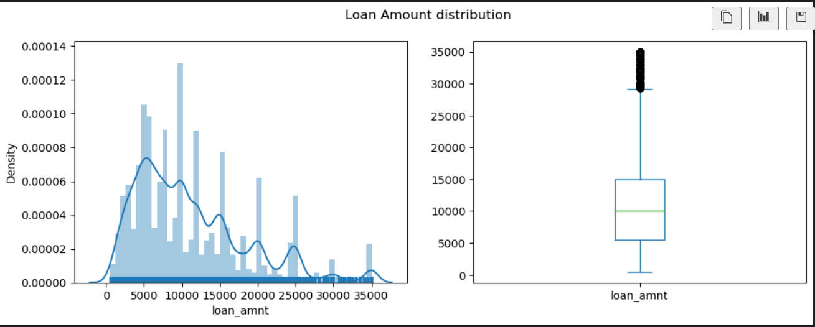
Univariate Analysis
Analyze content of categorical columns and numerical columns and clean if needed
Covert values to proper int ,float and date representations
Check for outliers
Observation: Most people have taken loan of around 10K as median and mean both are around same value. Maximum people have taken a loan of less than 25K as it is the 95th percentile of data distribution, after that only few people have taken loan in range of 25K to 35K

Slide 9
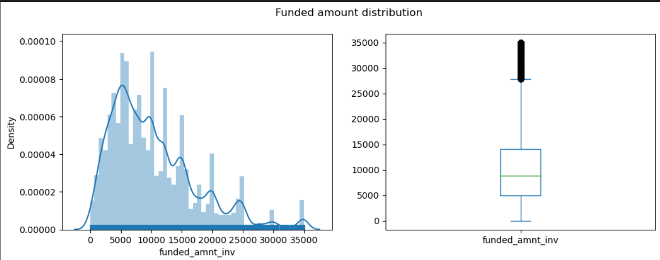
Observation: Most people have taken loan of around 10K as median and mean both are around same value. Maximum people have taken a loan of less than 25K as it is the 95th percentile of data distribution, after that only few people have taken loan in range of 25K to 35K

Slide 10
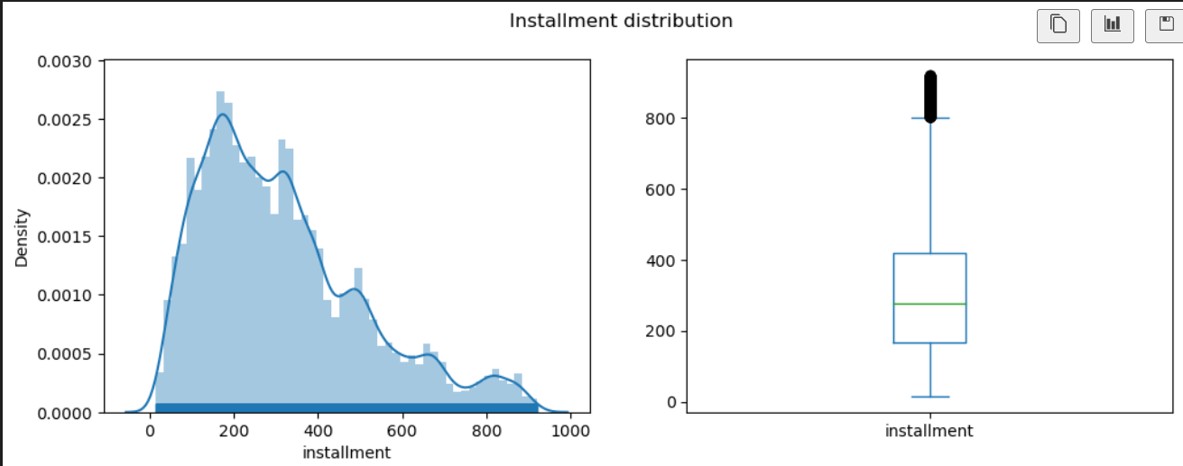
Observation: Installment distribution is static after 921 of value, 99 percentile is at 921 and for 1 percentile people installment is more than that. As per analysis , this is for people who applied for a loan of more than 25000. We can drop the outliers for installment

Slide 11
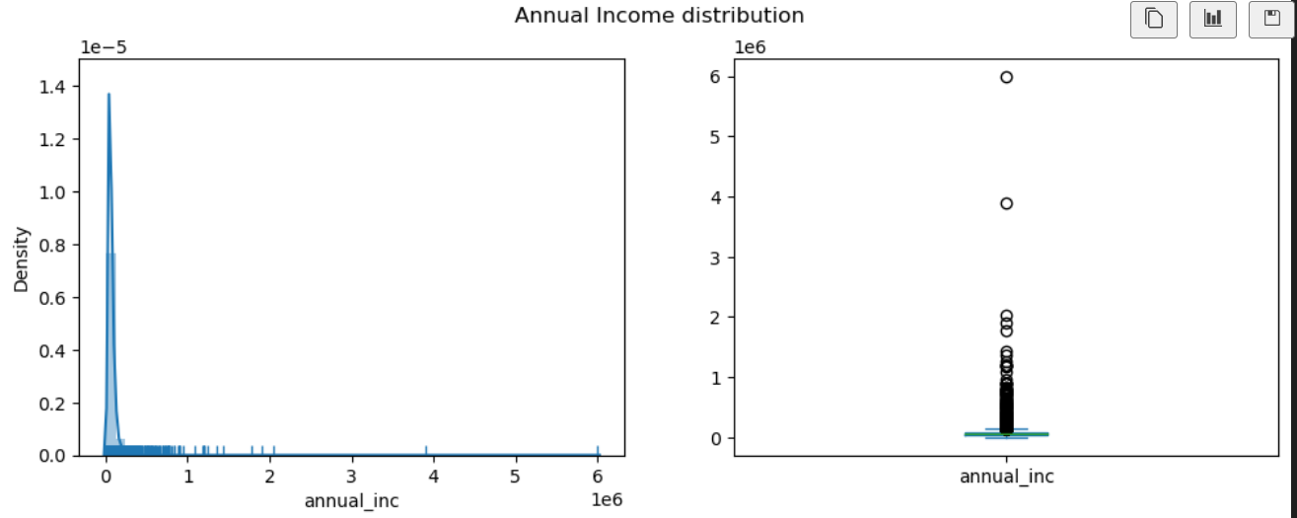
Observation: There are a lot of outliers in annual income field, 99 percentile customers have annual income below 235K and rest are outliers and we can skip from data

Slide 12
Bivariate ANalysis

Slide 13
Multivariate ANalysis

Slide 14
Conclusion

Slide 15
THANK YOU
Astha Agarwal
Vinay Prasad
Astha
Vinayprasadk1990@gmail.com

